Slide 1



Unlock Real-Time AI-ML
Event Streaming
with Spring and Cloud Native Data Services

Slide 2

Gregory Green
Principal Solution Architect
VMware By Broadcom

Slide 3
Goal
What is AI/ML?
Agenda
Technologies Spring & Data Services
Cloud Native Architecture
Conclusion

Slide 4
Goal
How can we understand information to make informed decisions quicker?

Slide 5

Information
Letter message content….

Slide 6
Is this information Good or Bad?
Is this Real?
Information
Letter message content….
Is this information Dangerous?

Slide 7
Artificial
Intelligence
(AI)
Information
Letter message content….

Slide 8
What is Artificial Intelligence (AI)?
AI is technology that emulates human intelligence

Slide 9
What is Machine Learning (ML)?
ML is artificial intelligence that uses mathematical data algorithms

Slide 10
AI
AI
Is this information Good or Bad?
Sentiment Analysis
Is this Real?
Fraud Detection
Information
Letter message content….
Is this information Dangerous?
Threat Detection

Slide 11
Main Idea
AI
AI/ML can help humans understand information to make informed decisions quicker using Models
ML

Slide 12
What is a ML Model?
A Model is a Machine learning mathematical algorithm that is trained to produce an outcome
Model

Slide 13
Model algorithms are base supervised or unsupervised or reinforcement learning
How do ML Models learn?
Model
<Supervised>
Model
<reinforcement>
Model
<Unsupervised>
neural networks
decision trees
linear regression
hidden Markov
k-means
hierarchical clustering
Gaussian mixture
temporal difference
deep adversarial networks
Q-learning

Slide 14
AI Models Algorithm - categories
Classification
Classification is a ML model algorithm to associate data by a category
Anomaly
Anomaly is a ML model algorithm to identify deviation for normal trends
Regression
Regression is a ML model algorithm to predict outputs
Clustering
Clustering is ML model algorithm to group similar data points

Slide 15
Sentiment Analysis
Classification
Classification is a ML model algorithm to associate data by a category
Fraud Detection
Information
Threat Detection
Letter message content….

Slide 16
Inferencing
Inferencing refers to providing a Model input that produce output based on training data
Information
Model
Output=Sentiment Analysis
Input=Letter message content….

Slide 17
Models are provided with training data that is labeled to predict future outcomes based on data trends
How are models trained?
Model
Example Supervised ML Training Data
Text: "I absolutely love The Chosen series! The messaging is incredible, and it made me cry a couple of times." Sentiment: Positive
Text: "The grocery prices are so expensive. The cost of my favorites like fruits and chicken are so disappointing." Sentiment: Negative
Text: "I had a mixed experience at the restaurant. The food was good, but the service was very slow." Sentiment: Neutral
Text: "This book was for real! It had me shocked one minute and laughing the next." Sentiment: Positive
Text: "The customer support team was pretty rude. I cannot say I look forward to shopping there again." Sentiment: Negative

Slide 18

Large Language Models (LLM) support multiple categories of usage and are trained on enormous amounts of data such as information from the internet
Model
LLM

Slide 19


Can I use existing models?
Online Platforms like OpenAI with ChatGPT and Hugging Face and others have made it easy to use the power of AI in existing Models
ChatGPT
<unsupervised>
Model(s)
FREE!

Slide 20
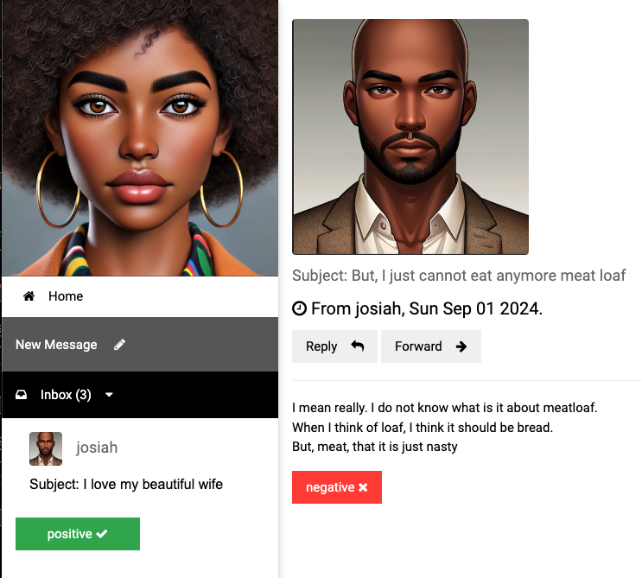
Sentiment Analysis

Slide 21
Getting started with AI/ML
Vector Embedding is a numerical representation of data
App(s)
=>
I love my awesome wife, she is my best friend
[ -0.5539689660072327, -0.04552192986011505, 0.2843276858329773, 0.12018735706806183, -0.4164251685142517, -0.0015744016272947192,
0.8378576636314392, -0.2455213963985443,
0.1919904500246048, 0.3389095067977905, 0.5132707357406616, -0.5949105024337769, -0.05128718167543411, 0.13099819421768188, 0.23817287385463715, 0.16531096398830414, -0.08132422715425491,,… ]

Slide 22
How are vector embeddings generated?
Text Embedding produces vector embedding based on text input
Model
<text-embedding>
App(s)
[ -0.5539689660072327, -0.04552192986011505, 0.2843276858329773, 0.12018735706806183, -0.4164251685142517, -0.0015744016272947192,
0.8378576636314392, -0.2455213963985443,
0.1919904500246048, 0.3389095067977905, 0.5132707357406616, -0.5949105024337769, -0.05128718167543411, 0.13099819421768188, 0.23817287385463715, 0.16531096398830414, -0.08132422715425491,,… ]
I love my awesome wife, she is my best friend
=>

Slide 23
How to perform sentiment analysis?
Model
<text-classification>
Model
<embedding>
App(s)
Text classification determines sentiment such as
-2=VERY_NEGATIVE, -1=NEGATIVE, 0=NEUTRAL,
1=POSITIVE 2=VERY_POSTIVE
Vector embedding
[ -0.5539689660072327, -0.04552192986011505, 0.2843276858329773, 0.12018735706806183, -0.4164251685142517, -0.0015744016272947192,
0.8378576636314392, -0.2455213963985443,
0.1919904500246048, 0.3389095067977905, 0.5132707357406616, -0.5949105024337769, -0.05128718167543411, 0.13099819421768188, 0.23817287385463715, 0.16531096398830414, -0.08132422715425491,,… ]
=>
=>
I love my awesome wife, she is my best friend

Slide 24

How to perform sentiment analysis?
Models
Spring AI
App(s)
Spring AI simplifies the use of ML models from libraries like Hugging Face and OpenAI for Java programing applications
I love my wife

Slide 25


How can apps receive data for sentiment analysis?
Event brokers provides real-time information event streaming
Spring AI
App(s)
Event
Broker

Slide 26
Why would you use RabbitMQ?
RabbitMQ streams can support millions of messages per second for inferencing
RabbitMQ streams can support replay messages for training
Event
Broker

Slide 27


How to store data?
A Database can store information to act as a system of record or an operational data store for data access
Database

Slide 28

How to learn from stored data?
Model
LLM(s)
Vector databases integrate data for Large Language models (LLM) with similar data as context to provide better outcomes (also known as Retrieval Augmented Generation (RAG).
<Vector>
Database

Slide 29
How to learn from stored data?
Model
LLM(s)
<Vector>
Database

Slide 30

How to get results faster?
Provides fast access to in-memory
most frequently used data information
Cache

Slide 31


Models
Models
Consumer Sink App
User
App
Event Processor
App
Data Services
Postgres ML
ValKey
RabbitMQ

Slide 32
Cloud Platform
Models
Models
Public or private Cloud platforms allow to easily scale AI/ML training and interference based on the volume of data and users
Event Processor
App
Consumer Sink App
User
App
Data Services
Postgres ML
RabbitMQ
ValKey

Slide 33



Cloud Native platforms
Cloud Native platforms like Kubernetes and Cloud Foundry simplify the deployment of applications and data services
Apps
Event
Broker
Cache
Database

Slide 34
How do cloud platforms simplify deployments?
A Container is a lightweight, package of software that contains everything needed to run apps and data services on a cloud platform
Container
Container
Container
Container

Slide 35
Models
Models
Cloud platforms like Kubernetes and Cloud Foundry provide provisioning, auto healing and scalability for Spring apps and data services like RabbitMQ, Postgres and ValKey running in containers
Event Processor
App
Consumer Sink App
User
App
Data Services
Postgres ML
RabbitMQ
ValKey

Slide 36
Conclusion
Goal: How can we understand information to make informed decisions quicker?
AI/ML
Help you to understand information based on mathematically algorithm models
Spring
Simplifies the use of ML models for Java programming applications for informed outcome-based decisions
Cloud Data Services
Cloud native platforms make it easy to run scalable services. Event streaming brokers like RabbitMQ provide real-time information, Vector databases like Postgres to improve model accuracy and caching services like ValKey provide faster data access anywhere.

Slide 37


Gregory Green
VMware By Broadcom
Connect with me on
LinkedIn
Demo
Source
Code

